Slide 1
Wellness Day 2020 Viruses, Epidemics & Pandemics
Nina Patel, MD
Associate professor
Division of pulmonary, allergy & Critical care
Columbia University
Notes:
Good morning everyone.
Thanks for having me today.
I’ll be discussing viruses, epidemics and pandemics, with a focus on the current pandemic, Covid 19. . .

Slide 2
Objectives
Definitions
Disease Transmission
SARS CoV2 (i.e. COVID 19)
What is it and what does it do?
SARS CoV2/CoVID 19
What do we do next?
Notes:
What we’ll do over the next half hour or so, is review a few things. First, some basic definitions, then a brief discussion of how disease are transmitted.
We’ll spend a lot of our time discussing the SARS CoV2 virus, also known as Covid 19.

Slide 3
Epidemics/Pandemics/Contagions
https://www.rottentomatoes.com/m/contagion_2011
Notes:
So to start off, other than a terror inducing movie on Netfix, what are epidemics/pandemics and contagions?

Slide 4
Definitions
Contagion
The transmission of a disease by direct or indirect contact
Epidemic
An outbreak of disease that spreads quickly and affects many individuals at the same time
Pandemic
An outbreak of a disease that occurs over a wide geographic area and affects an exceptionally high proportion of the population
“Exactly when enough places have enough infections to declare one (A PANDEMIC) isn’t a black-and-white decision. But generally, the WHO is looking for sustained outbreaks on different continents.”
-https://apnews.com
https://www.merriam-webster.com/dictionary/
Notes:
A number of definitions exist in the ether, so I tried to keep it straightfoward and use the merriam webster dictionary definitions. . .

Slide 5
Is CoViD 19 a pandemic?
Notes:
There is no standard definition. Pandemics trigger, generally a national response that is often dramatic and involves forced closings of mass gatherings/public events and surge procedures etc. in hospitals. . .

Slide 6
Prior Pandemics in History?
430 BC - Athens, during the Pelopennesian War
Possibly typhus, contributed to Athens defeat by Sparta
165 AD – The Antonine Plague
Possibly smallpox, spread through the Roman empire and led to the death of Marcus Aurelius
1350 – The Black Death, Bubonic Plague
Death of 1/3rd of the world’s population
1918 - Spanish Flu
Death toll: 20 to 50 million; 1-3% of the world’s population
1981 – 2012 - HIV/AIDS
Death toll: 36 million
2009 – H1N1 (Swine Flu)
Death toll: ~151 to 575,000 (0.02% CFR)
11-21% global population affected
https://www.mphonline.org/worst-pandemics-in-history/
https://www.history.com/topics/middle-ages/pandemics-timeline
Notes:
Population in 1300 ~ 443 million -> 350 million post pandemic
Typhus- Rickettsia prowazekii- transmitted through lice
Smallpox- viral, transmitted through
Plague- bacterial, transmitted via fleas and rodents

Slide 7
Objectives
Definitions
Disease Transmission
SARS CoV2 (i.e. COVID 19)
What is it and what does it do?
SARS CoV2/CoVID 19
What do we do next?

Slide 8
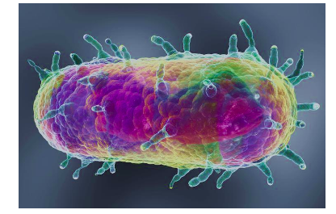
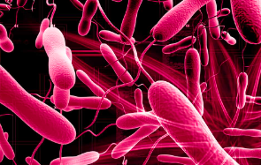
What organisms cause pandemics?
Bacteria – e.g. Yersinia pestis, Vibrio cholera
https://www.creative-biolabs.com/vaccine/yersinia-pestis-vaccines.htm
https://www.creative-biolabs.com/vaccine/vibrio-cholerae-as-vaccine-vectors.htm
Notes:
Bacteria- single cell organisms
Yersinia- GNR, enterobacter family; Vibrio cholera – GNR

Slide 9
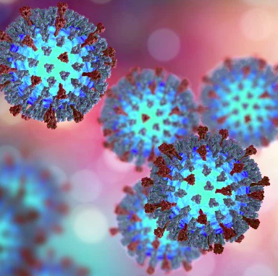
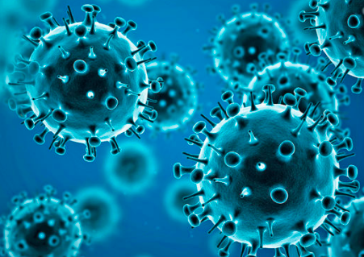
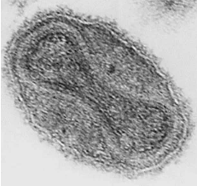
What organisms cause pandemics?
Viruses – e.g. Influenza, Smallpox, Measles
Influenza
Small pox
Variola virus
Measles
Rubeola virus
https://hospitalcmq.com/diseases-and-conditions/what-is-the-flu-ten-things-to-know/
https://time.com/4020708/smallpox-last-death/
Notes:
Viruses- genetic information + a protein shell (not actual living organisms) -> invade healthy cells and multiply
Influenza – multiple carriers across mammals though also avian carriers. Classically, avian strains don’t cross to humans, though transmission has occurred. . . Domestic poultry. Pigs/swine are felt to potentially be able to be a mixing pot of avian and mammalian viruses than can then get transmitted in each direction.
Small pox- transmitted from person to person via respiratory droplets. Dr. Edward Jenner created a vaccine that eventually led to elimination.
Measles/Rubeola- human to human through infected droplets; however, since dz particles can remain in the air for up to 2 hours, also require droplet iso

Slide 10
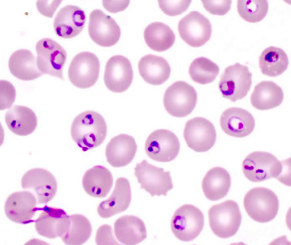
Other organisms that can cause infection & disease outbreaks
Fungi – Aspergillus, Cryptococcus
Protozoa – Plasmodium species (i.e. malaria), Giardia
https://microbeonline.com/aspergillus-fumigatus-characteristics-pathogenesis-diagnosis/
https://www.researchgate.net/figure/Cryptococcus-neoformans-capsule-and-cell-wall-Clockwise-from-upper-left-Negative-stain_fig1_324504826
http://www.pathologyoutlines.com/topic/parasitologymalariapfalciparum.html
Notes:
Bacteria- single cell organisms
Viruses- genetic information + a protein shell (not actual living organisms) -> invade healthy cells and multiply

Slide 11
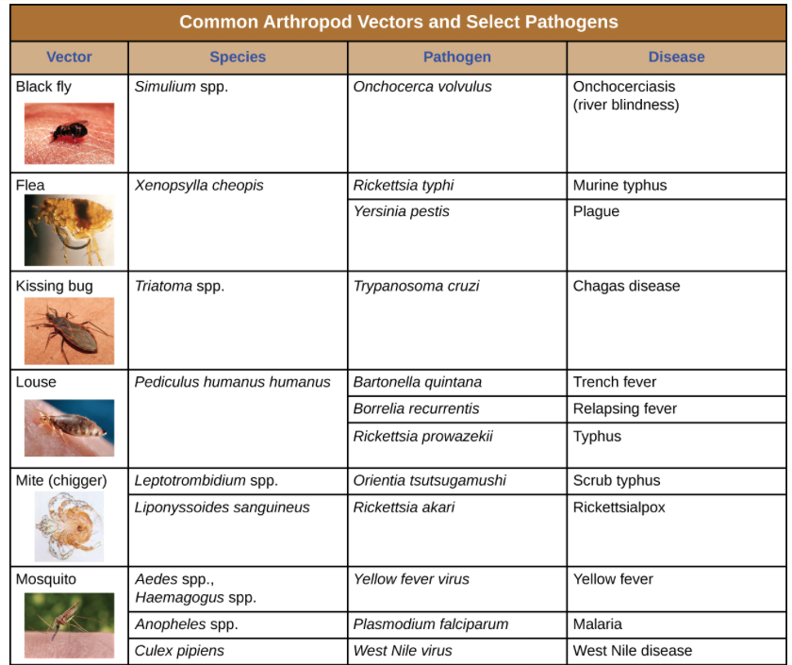
How are microbes transmitted?
Transmission
Vectors
Fleas, Mosquitos, Lice, etc.
https://openstax.org/books/microbiology/pages/16-3-modes-of-disease-transmission

Slide 12
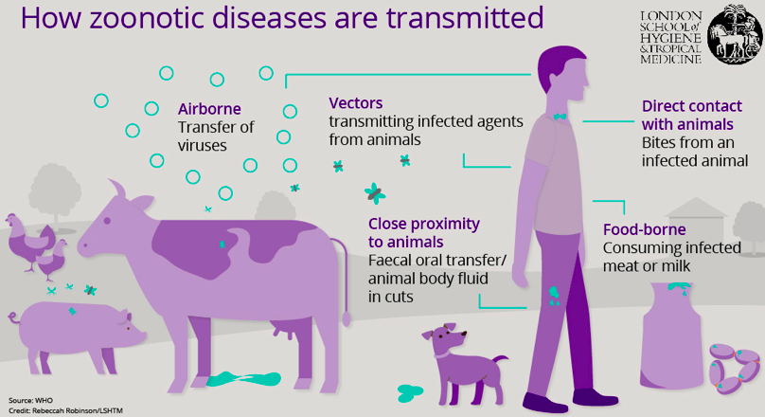
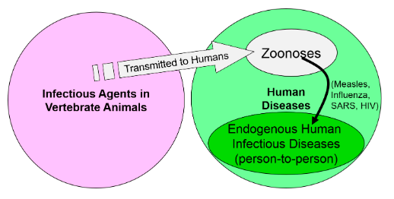
How are microbes transmitted? Zoonotic transmission
https://foodsource.org.uk/book/export/html/108
http://sphweb.bumc.bu.edu/otlt/MPH-Modules/PH/PH709_Transmission/PH709_Transmission6.html

Slide 13
Human to Human Transmission
https://www.nationalgeographic.org/media/methods-disease-transmission/
Notes:
The R0- how many people become infected from one infected person. . .

Slide 14
How cough droplets spread
https://www.businessinsider.com/how-far-sneeze-cough-germs-can-travel-2018-10?jwsource=cl

Slide 15
How are microbes transmitted? Human to human transmission
Virus transmission
Respiratory droplet – RSV, Rhinovirus, SARS
Airborne – Measles (Rubeola)
Bloodborne – HIV, Ebola, Marburg
STDs – HSV, HIV
Fecal-oral – Norovirus, Rotavirus
https://www.vox.com/2020/1/31/21113178/what-is-coronavirus-symptoms-travel-china-map
Notes:
The R0- how many people become infected from one infected person. . .

Slide 16
How do viruses cause disease?

Slide 17
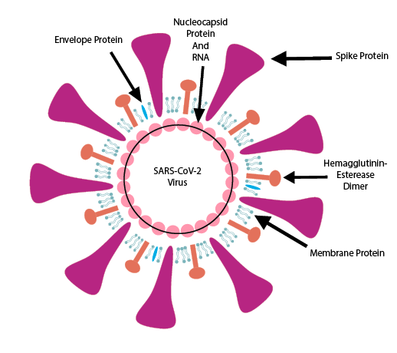
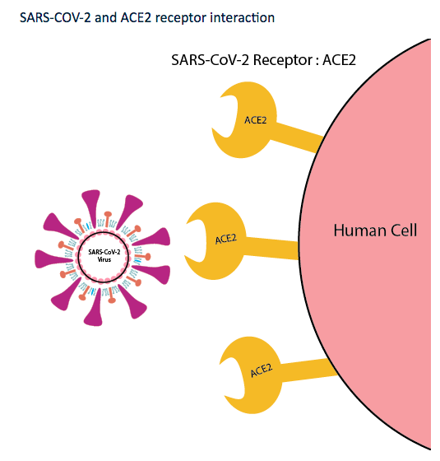
How does SARS CoV2 cause disease?
https://www.prosci-inc.com/ace2-antibodies/

Slide 18
How does SARS CoV2/CoviD19 cause disease?
Virus entry
(Contact -> Nose/mouth/eyes and/or Inhalation of respiratory droplets)
Virus binding to receptors in respiratory tract (ACE receptor)
Virus invades the cell & replicates (multiplies)
Viral particles are released into the respiratory tract and then into the bloodstream (ACE receptors also in blood vessels, myocytes, intestines)
Inflammation in the lungs and the body

Slide 19
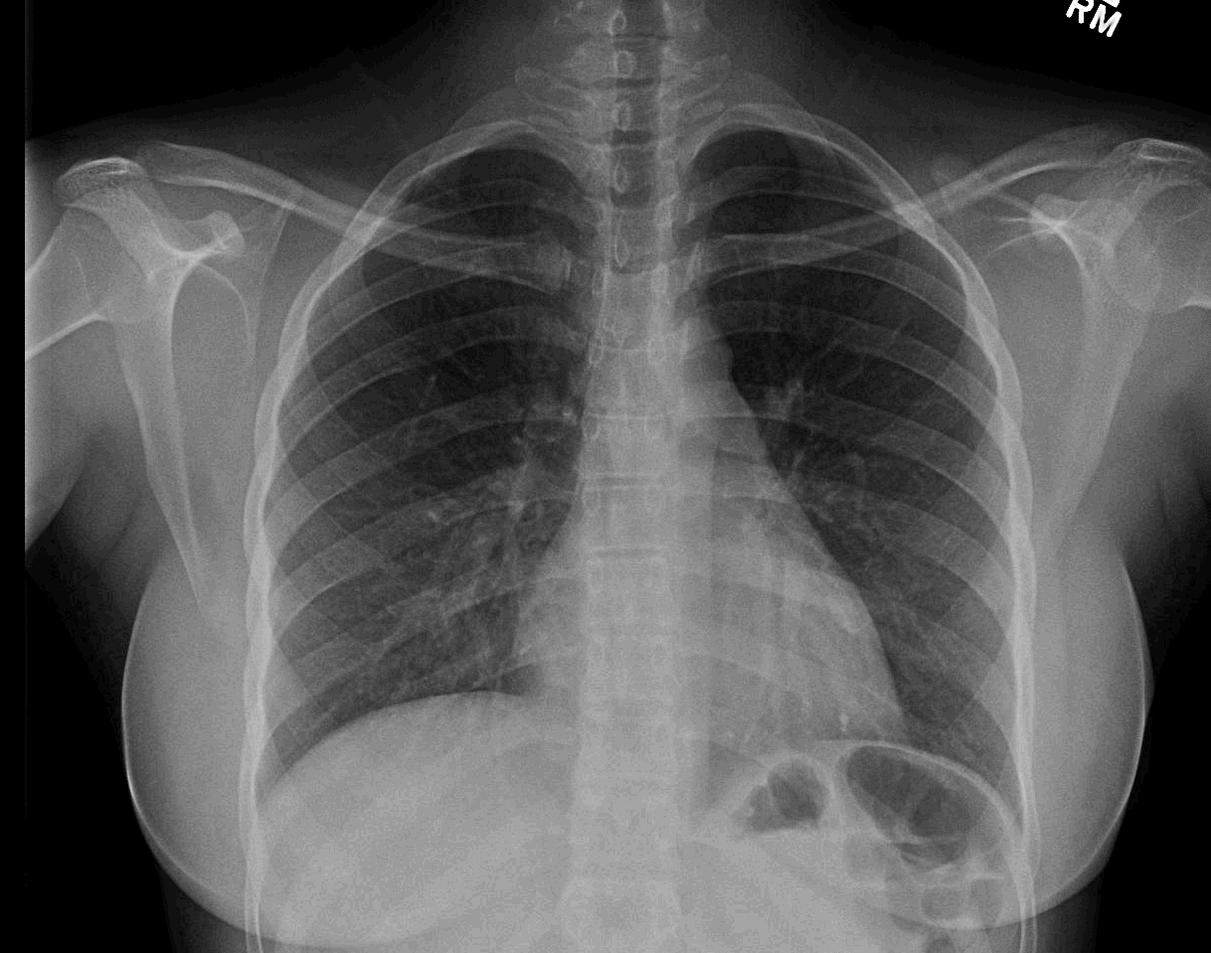
61 Year-Old Male with pneumonia
Normal
Illness Day 11

Slide 20
Objectives
Definitions
Disease Transmission
SARS CoV2 (i.e. COVID 19)
What is it and what does it do?
SARS CoV2/CoVID 19
What do we do next?

Slide 21
What is SARS CoV2/COVID-19?
Family of viruses -> Coronaviridae
Single-strand RNA, 26 to 32 kB
Hosts: Avian, Bats, camels/dogs/cats/civets/mice
6 coronaviruses known to affect humans previously, now 7
SARS-CoV, MERS-CoV, SARS CoV2
Notes:
https://www.nytimes.com/article/what-is-coronavirus.html
Target respiratory epithelial cells

Slide 22
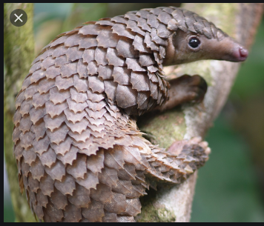
How did SARS CoV2/CoVID19 emerge as a pathogen in humans?
86.9% nucleotide sequence similarity to a CoV which infects only bats
68% similarity with SARS-CoV
* Bat -> Intermediate Host suspected -> Humans
Lu R, Zhao X, Li J et al. Lancet 2020;395:565-574.
http://sphweb.bumc.bu.edu/otlt/MPH-Modules/PH/PH709_Transmission/PH709_Transmission6.html
Notes:
Bats hibernating at time of infection
Bat Co-V close but not exact, suggesting an intermediary host
Bats not sold at Huanan

Slide 23
How is SARS CoV2/COVID-19 transmitted?
Transmitted via
Spread by being in close contact
6 feet distance recommended to avoid transmission
Coughing/sneezing – spread of respiratory droplets
Fomite transmission being explored
Fecal-oral transmission suspected
Blood transmission may also occur
https://www.npr.org/sections/goatsandsoda/2020/01/22/798277557/how-does-wuhan-coronavirus-compare-to-mers-sars-and-the-common-cold
Notes:
https://www.nytimes.com/article/what-is-coronavirus.html
Target respiratory epithelial cells

Slide 24
Beginnings of the Outbreak
December 29th:
First 4 cases identified by hospitals using “pneumonia of unknown etiology” surveillance mechanism
Cases all linked to Huanan Seafood Wholesale Market in Wuhan
January 1st
Market closed
Notes:
FigureTimeline of early stages of 2019-nCoV outbreak
2019-nCoV=2019 novel coronavirus.
BAL samples collected in which virus identified
https://www.thelancet.com/journals/lancet/article/PIIS0140-6736(20)30185-9/fulltext#figures

Slide 25
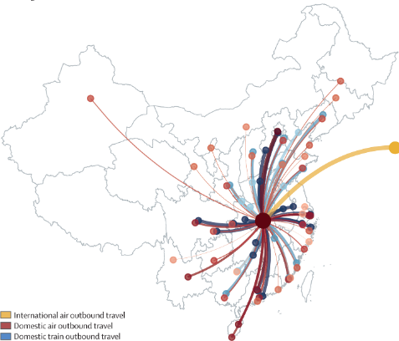
From Local Outbreak to International Epidemic
12/31/2019: China alerts WHO
1/1/2020: Huanan Seafood Wholesale Market closed
1/7/2020: Novel Coronavirus isolated and identified
1/11/2020: China announces first death
1/13/2020: First case confirmed outside China (in Thailand)
1/23/2020: Wuhan quarantined (planes, trains, buses, subways and ferries halted)
1/24/2020: quarantine expanded to Hunggang, Ezhoue, and other cities in Hubei province
2/2/2020: First death outside China (Phillippines)
Notes:
https://www.nytimes.com/interactive/2020/world/asia/china-wuhan-coronavirus-maps.html

Slide 26
Notes:
https://www.nytimes.com/interactive/2020/world/asia/china-wuhan-coronavirus-maps.html

Slide 27
Worldwide cases coronavirus- 3/12/2020
125, 048 cases
117 countries
6 continents
4,613 deaths
Notes:
3.69%

Slide 28
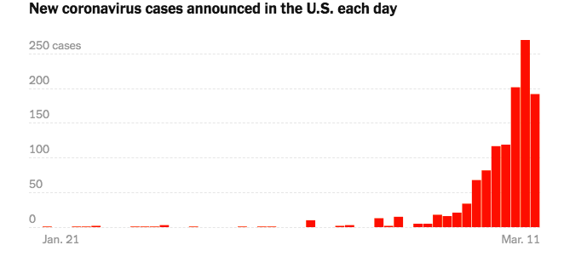
U.S. cases coronavirus - 3/11/2020
***1,215 cases; 36 deaths -> NY and Washington State most affected

Slide 29
High Transmissibility Key to Growth
 | SARS-CoV-2 | MERS-CoV | SARS-CoV
Date | 12/2019 | 6/2012 | 11/2002
Location of first detection | Wuhan, China | Jeddah, Saudi Arabia | Guangdong, China
Age, years (range) | 49 (21–76) | 56 (14–94) | 39·9 (1–91)
Confirmed cases | 126,000+ (3/11/20) | 2494 | 8096
Mortality | 4,613 (1-3%) | 858 (37%) | 744 (10%)
Ro | 2-3.5 | <1 | 2-4
Incubation period ~ 5 days
https://www.nejm.org/doi/10.1056/NEJMc2001737
Notes:
Viral shedding
Median duration viral shedding 20 days (17-24 days)
Total span 8 to 37 days
(patients tested every other day

Slide 30
SARS CoV2/COVID-19 Clinical Features
Symptom | Prevalence
Fever | 87.9%
Dry Cough | 67.7%
Fatigue | 38.1%
Sputum/”Wet Cough” | 33.4%
Shortness of breath | 18.6%
Muscle aches/Joint aches | 14.8%
Sore throat | 13.9%
Headache | 13.6%
Chills | 11.4%
Nausea/Vomiting | 5%
Diarrhea | 3.7%
WHO/Joint Commission Report
55,924 Cases From China
77.8% -> 30 to 69 y.o.
2.4% of cases < 18 y.o.
https://www.who.int/docs/default-source/coronaviruse/who-china-joint-mission-on-covid-19-final-report.pdf

Slide 31
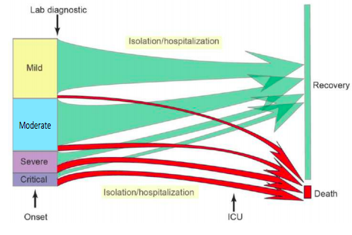
SARS CoV2/COVID-19 Clinical Features
80% of people have mild to moderate disease
13.8% have severe disease
6.1% are critical
https://www.who.int/docs/default-source/coronaviruse/who-china-joint-mission-on-covid-19-final-report.pdf
Notes:
Severe- requiring hospital care
Critical- ICU care/shock
28% mortality in Lancet paper for hospitalized patients

Slide 32
SARS CoV2/COVID-19 Clinical Features
Case Fatality Rate -1.4%
Risk factors for severe dz
Older age
Comorbid dz, Chronic lung illness, cancer
50% of hospitalized patients had co-morbid conditions
HTN, DM, CAD, COPD, CKD, Other
Notes:
Older age (>60)

Slide 33
How is SARS CoV2/CoVID19 diagnosed?
History & Symptoms
Travel to CDC Level 2 or higher countries
Contact w/a known CoVID19+ patient or PUI for CoVID19
Fever, Cough, shortness of breath
Fatigue, Body aches
Diagnostic testing
Nasal and throat swab
RT-PCR
Initially, only through CDC/DOH -> now some local testing available, still limited
https://ucl.testcatalog.org/show/474

Slide 34
Objectives
Definitions
Disease Transmission
SARS CoV2 (i.e. COVID 19)
What is it and what does it do?
SARS CoV2/CoVID 19
What do we do next?

Slide 35
Containment vs. Mitigation (i.e. minimizing the impact)

Slide 36
Flatten the Curve. . .
https://giphy.com/gifs/delay-covid19-containment-dWCcpgCRiOHk5B8znA
Notes:
Prevent
Detect
Respond

Slide 37
How do we limit spread in our community?
Wash your hands!
After sneezing, blowing your nose, touching your face, being out in public places, going to the bathroom, before/after eating,
Avoid touching your face
Clean and disinfect frequently touched objects/surfaces
Get a flu shot!
Save the masks for if you are sick. If not, please save them for health care providers
Notes:
How long to wash hands?
Alcohol based hand sanitizer at > 60%

Slide 38
How do we limit spread in our community?
Increasingly:
Social distancing
Avoidance of large/mass gatherings
Decreasing public transport or commuting on off hours
Travel bans
Quarantines
https://medium.com/@tomaspueyo/coronavirus-act-today-or-people-will-die-f4d3d9cd99ca

Slide 39
What happens if we do not implement social distancing?
https://medium.com/@tomaspueyo/coronavirus-act-today-or-people-will-die-f4d3d9cd99ca

Slide 40
Influenza 2019-2020 Season

Slide 41
What happens next?
*Vaccine development
https://www.nature.com/articles/nrd.2015.37
https://www.mayoclinichealthsystem.org/hometown-health/speaking-of-health/top-5-faq-about-vaccines

Slide 42
SARS CoV2 Vaccine Development

Slide 43
Influenza 2019-2020 Season

Slide 44
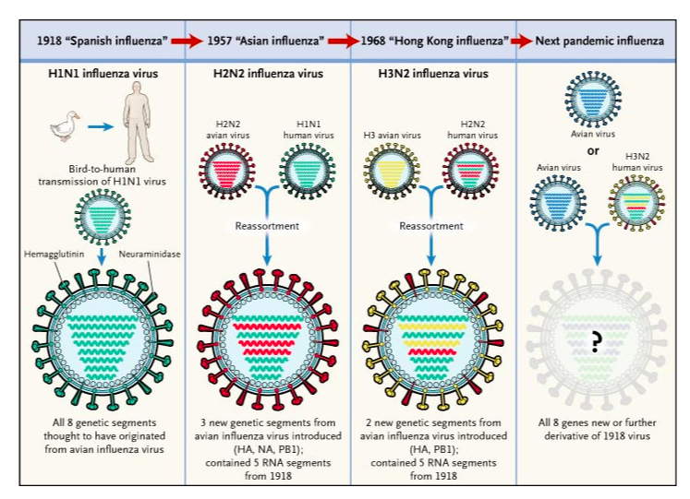
Seasonal flu cycles/viral adaptation
http://www.nejm.org/doi/full/10.1056/NEJMp058281
Notes:
Respiratory droplet containing the virus is not as stable in warm temperatures
Upper epithelial tract is preferred site of infection

Slide 45
SARS CoV2/CoVID19 Adaptation
Tang X, Wu C, Li X et al. National Science Review 3/3/2020.

Slide 46
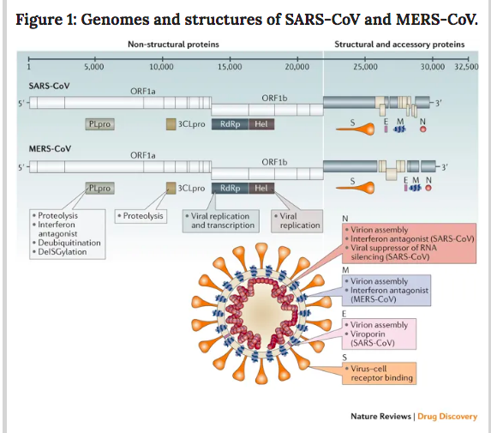
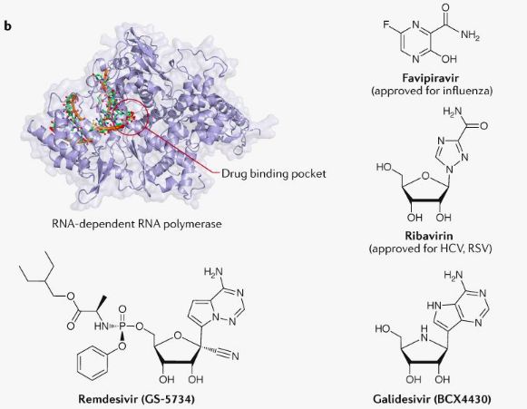
Anti-viral medication testing
https://www.nature.com/articles/nrd.2015.37
https://www.mayoclinichealthsystem.org/hometown-health/speaking-of-health/top-5-faq-about-vaccines
Notes:
Nucleoside (adenosine analogue)- gets incorporated into RNA and stops further replication

Slide 47
Questions?

